Slide 1
Preparing for the STM32U5 Azure IoT Hands-on Workshop

Slide 2
Contents
All steps must be completed BEFORE
Starting the STBOX Hands-On Workshop
1
Workshop Prerequisites
3
ST Tool Validator
2
Software Setup
4
BLE Firmware Patching

Slide 3
Workshop Prerequisites
This hands-on training is a working session and requires a PC or laptop running the 64-bit version of Windows® 10 or later
Administrator rights are needed for software and driver installation
One spare USB port will be required
You will need the following hardware for the workshop:
B-U585I-IOT02A Discovery Kit (provided)
USB-A to Micro-B cable (provided)
Notes:
Prior to the start of the workshop, please ensure that you have prepared the following:
A laptop or desktop running the 64-bit version of Windows 10,
Administrator rights for the computer, as they are needed for software and driver installation,
One spare USB Type-A receptacle,
An iOS or Android device with Bluetooth enabled
Internet connectivity is required for connection to the cloud dashboard
You will receive the following hardware for the workshop:
STEVAL-MKSBOX1V1

Slide 4
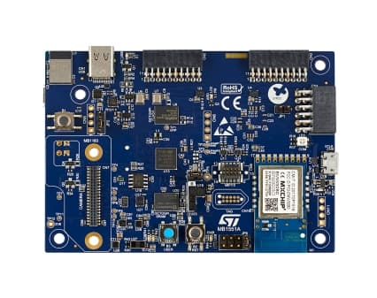
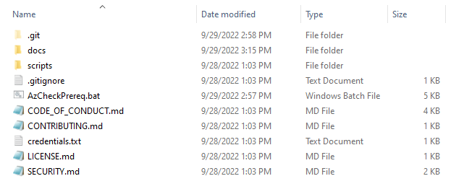
Workshop - Preparation
HW Platform: B-U585I-IOT02A
Software Content

Slide 5
Software Prerequisites
Python 3: Object oriented open-source programming language
Pip: Python package installer
Pyserial: Python library used for Serial Communication
Azure Command Line Interface (AZ CLI): set of commands used to create and manage Azure resources
STM32CubeProgrammer: all-in-one multi-OS software tool for programming STM32 products
X-CUBE-AZURE: Expansion Package that consists of a set of libraries and application examples for STM32U5 Series microcontrollers acting as Azure IoT end devices

Slide 6
AzPrereqCheck.bat Description
This script validates that the host machine meets all the required prerequisites:
Python 3
Pip
Pyserial
Azure Command Line Interface (AZ CLI)
STM32CubeProgrammer
X-CUBE-AZURE
Active Azure account
If a tools isn’t installed the script will download (if applicable) and install it

Slide 7
Step by step Guide
Follow the instructions (this document)
Run the prerequisite installation and validation tool
1)
2)

Slide 8
Running AzCheckPrereq.bat
Double click the AzCheckPrereq.bat
2)

Slide 9
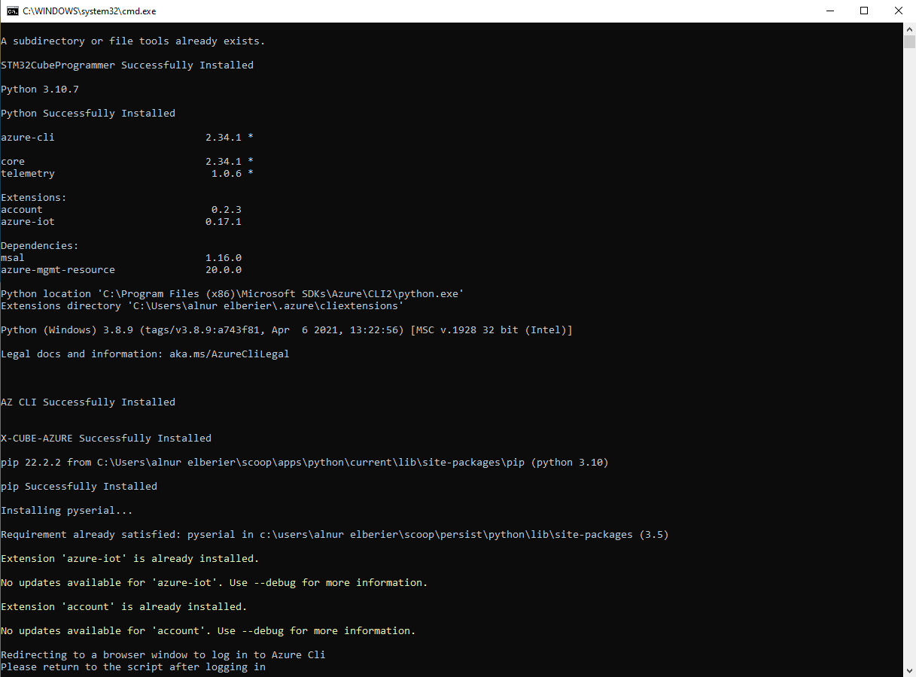
Running AzCheckPrereq.bat
In the case that you have the prerequisites installed the window will look as follows
NOTE: IF YOU ARE MISSING ANY REQUIRED SOFTWARE THE SCRIPT WILL INSTALL IT TO YOUR MACHINE AND PROMPT YOU TO RUN AGAIN

Slide 10
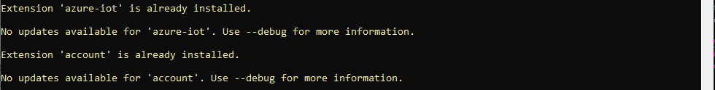
Running AzCheckPrereq.bat
If dependencies were installed by the script, please run the script again.
The script will then add a few necessary Az CLI extensions

Slide 11
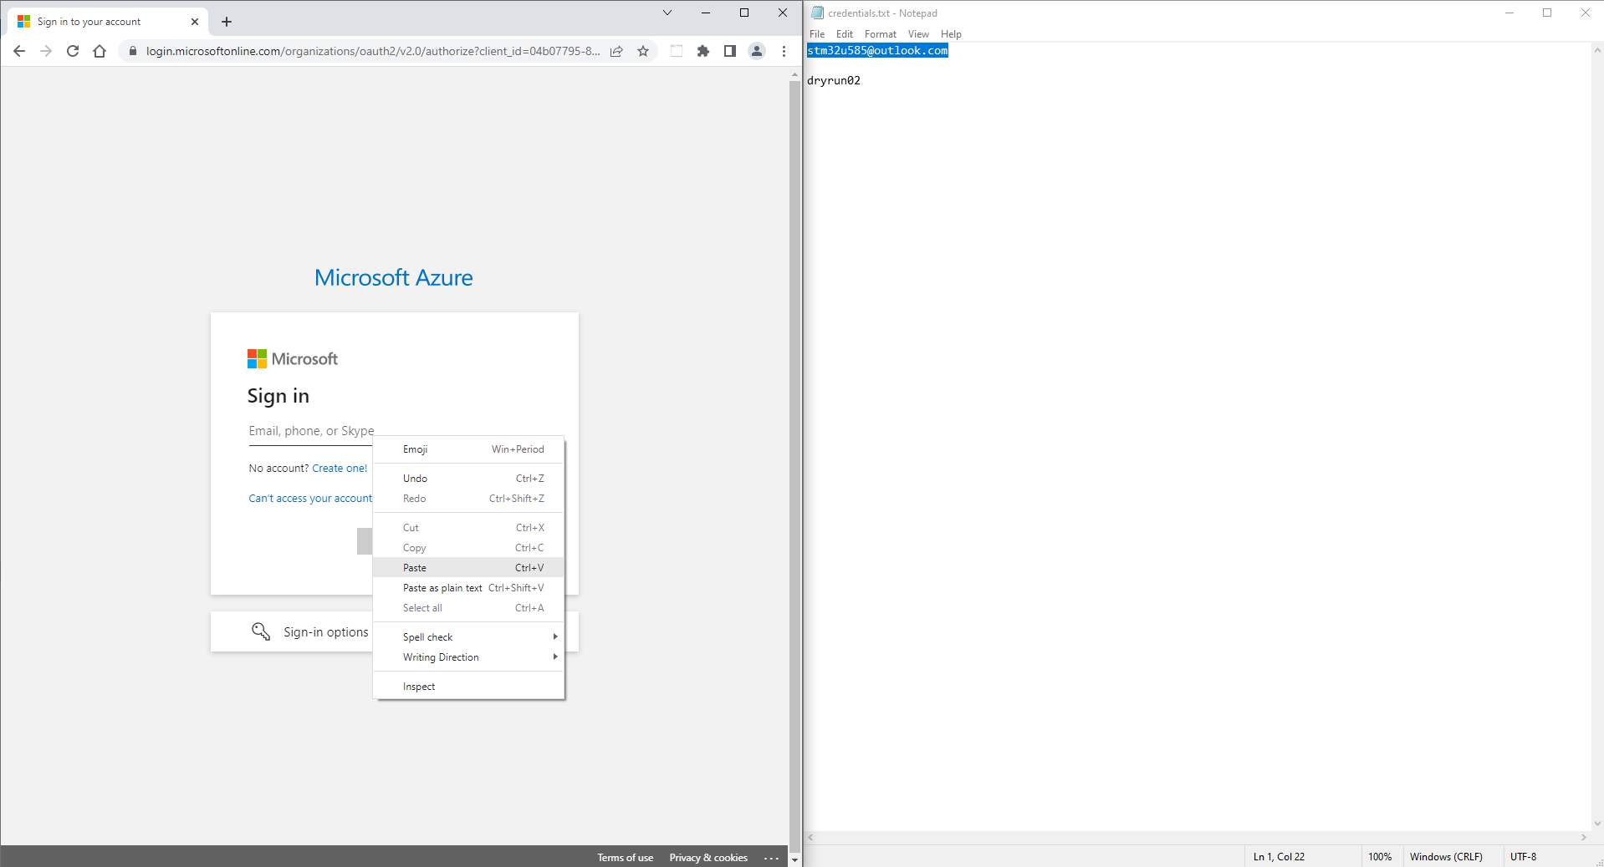
Running AzCheckPrereq.bat
The script will then open an Azure Login page and a Text file
Please copy/paste the credentials to login to the provided Azure Account

Slide 12
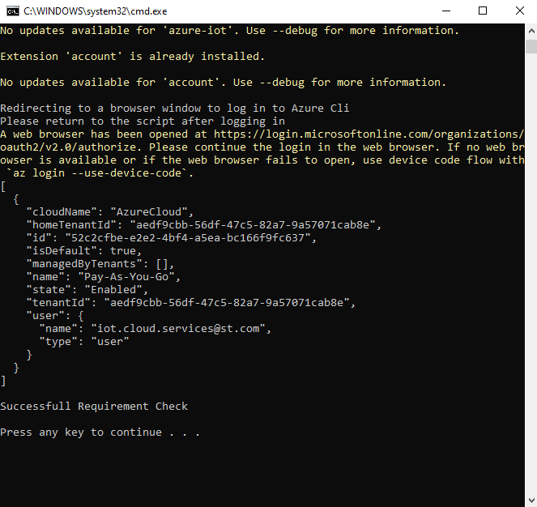
Running AzCheckPrereq.bat
Navigate back to the script window to verify that you have a ‘Successful Requirement Check’
When this message is displayed the host machine is ready to begin the hands on

